Slide 1
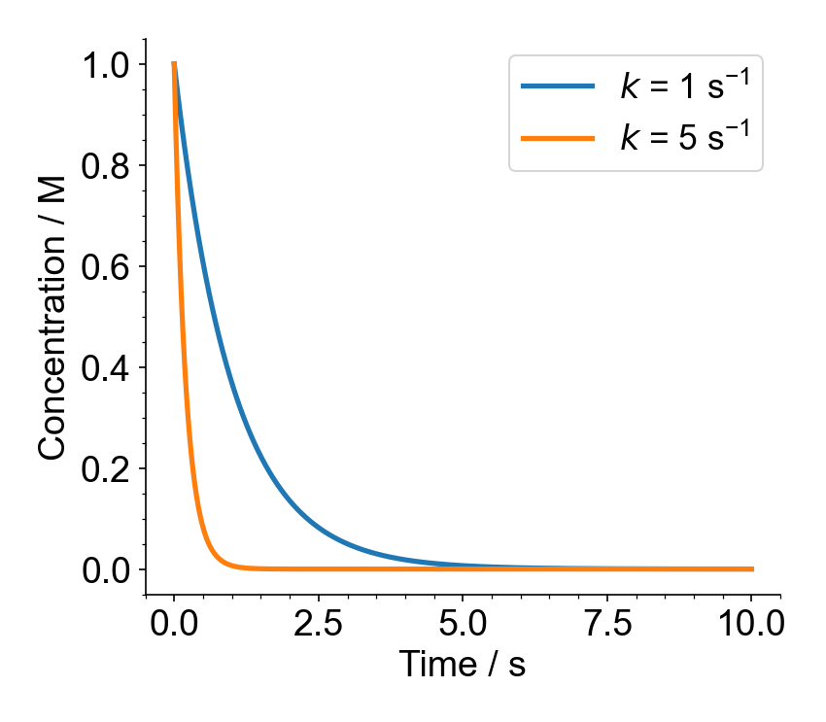
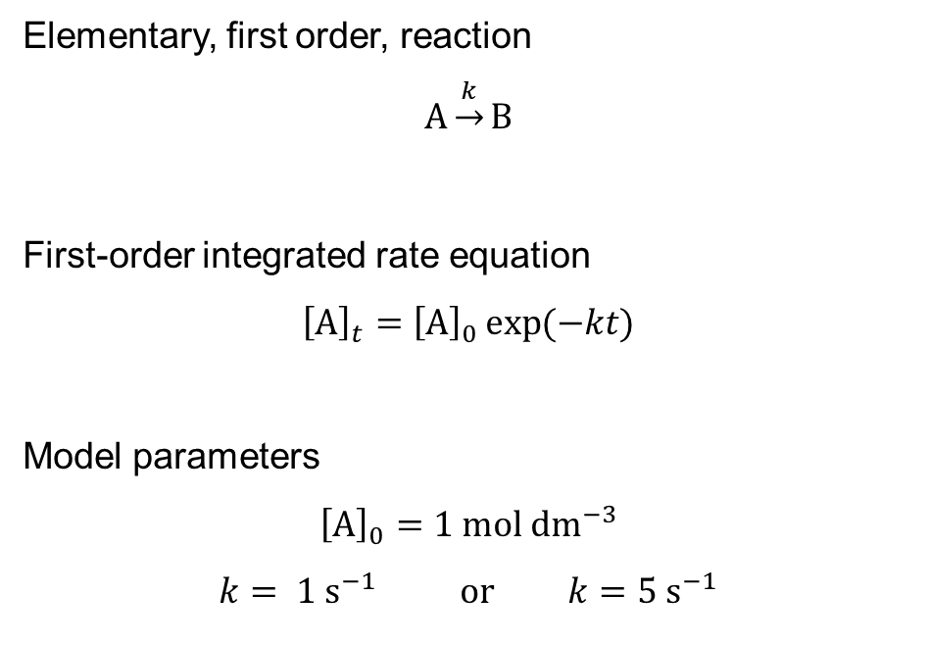
First Order Kinetics
Elementary, first order, reaction
$$A\underset{→}{k}B$$
First-order integrated rate equation
$${\left[A\right]}_{t}={\left[A\right]}_{0}\exp{(−kt)}$$
Model parameters
$${\left[A\right]}_{0}=1 mol {dm}^{−3}$$
$$k= 1 s^{−1} or k=5 s^{−1}$$

